Slide 1
CS5008 FINAL PROJECT
Finding the Best Route
Comparing A* and Dijkstra's Algorithm on a Two-Dimensional Grid
Presented by JSD Squad
Jenny Zhuo Wang • Sandra Yang Huang • Doudou Lei Tuo

Slide 2
Agenda
01
Introduction and Use Case
06
Data Structure
From graph theory to a working
terminal visualizer.
Why pathfinding matters
The priority queue (min-heap)
02
Pathfinding problem
07
Implementation
What is graph search?
Program architect
03
Principle of Dijkstra
08
Demo
Cost-driven exploration
30×30 grid walkthrough
04
Principle of A*
09
Testing cases
Adding a heuristic
Validation results
05
A* vs Dijkstra
10
Q & A
Side-by-side comparison
Discussion
CS5008 Final Project | JSD Squad
2

Slide 3
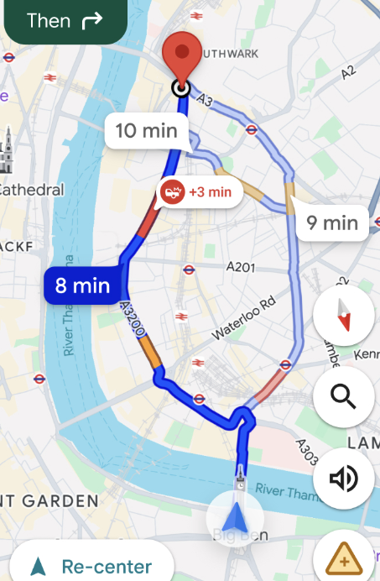

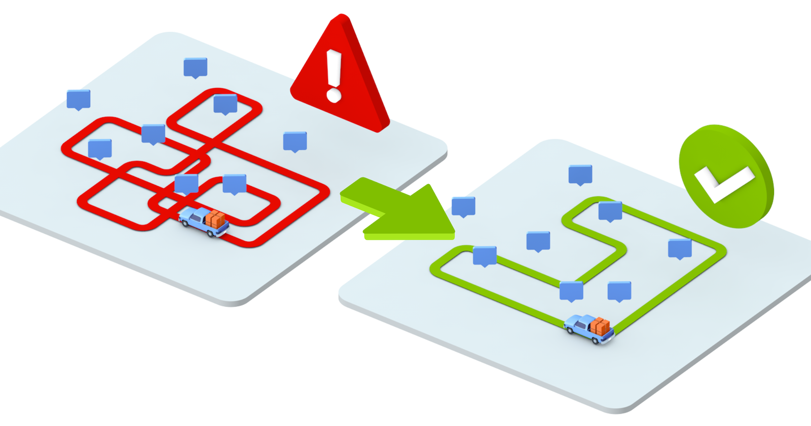
01 · INTRODUCTION – REAL LIFE USE CASE
Where Shortest-Path Search Shows Up
1
2
Networks
Lowest-cost routing of packets across weighted network links.
2
GPS & Maps
2
Robotics
Motion planning for a robot moving through a mapped environment.
Wayfinding
3
Turn-by-turn routing on real road networks with varying costs.
4
Games
NPC / unit navigation around obstacles in real time (RTS, RPGs).
Target destination
Delivery
Our Project
We built a 30×30 terminal grid where the user picks a Start and Goal, then watches A* and Dijkstra solve the exact same map back-to-back — same walls, same start/goal — so their behavior can be compared directly, frame by frame.
CS5008 Final Project | JSD Squad
4

Slide 4
02 · PATHFINDING
Pathfinding is a Graph Search Problem
S → G on a 30×30 grid
A map becomes a graph: a set of locations ("nodes") and the connections ("edges") between them. The search algorithm never sees rooms, doors, or terrain — it only sees the graph.
S
Frontier A priority queue of cells waiting to be explored next.
cost_so_far (g) Distance already travelled from the Start.
came_from Parent pointers used to rebuild the final path.
Goal Find the shortest path from S to G, avoiding walls.
G
● Start ● Goal ● Path ● Wall
Source: Patel, A. J., “Introduction to the A* Algorithm,” Red Blob Games. https://www.redblobgames.com/pathfinding/a-star/introduction.html
CS5008 Final Project | JSD Squad
3

Slide 5
03 · PRINCIPLE
One Search Loop, Two Ways to Score Priority
Dijkstra and A* share the exact same search loop — our code implements both from a single runSearch() function. The only difference is the formula used to compute each cell’s priority in the queue.
1
Pop the lowest-priority cell from the frontier
priority(cell) = ?
2
If already expanded, skip it (stale entry)
Dijkstra
3
Mark it visited; if it's the Goal, stop early
priority = g
4
Look at its 4 neighbors (up / down / left / right)
A*
5
If a cheaper path to a neighbor is found, push it with a new priority
priority = g + h
g = cost_so_far | h = heuristic (estimate to Goal)
CS5008 Final Project | JSD Squad
5

Slide 6
03 · PRINCIPLE — DIJKSTRA
Dijkstra's Algorithm: Expand by True Cost
Dijkstra (a.k.a. Uniform Cost Search) orders the frontier purely by cost_so_far (g) — the real distance already travelled from Start. It has no notion of where the Goal is, so it expands outward like a ripple, equally in every direction, until the Goal is popped off the queue.
Frontier expands as concentric rings
Goal
From our pqueue.c / main.c:
int priority = newCost; // g only
pqPush(&frontier, nr, nc, priority);
Start
Guaranteed to find the shortest path
Explores in all directions — no bias toward the Goal
Typically visits more nodes than A* on the same map
Goal could be anywhere on the outer ring —
Dijkstra treats every direction the same.
CS5008 Final Project | JSD Squad
6

Slide 7
04 · PRINCIPLE — A*
A*: Add a Heuristic to Aim at the Goal
A* keeps Dijkstra’s g but adds a heuristic h — an estimate of the remaining distance to the Goal. On a 4-directional grid we use the Manhattan distance: h = |row − goalRow| + |col − goalCol|. Priority becomes f = g + h, so cells that look closer to the Goal are explored first.
Frontier stretches toward the Goal
Goal
From our main.c:
int priority = newCost + heuristic(nr, nc);
// heuristic = |dr| + |dc| (Manhattan)
Still guaranteed optimal — as long as h never overestimates (“admissible”)
Manhattan distance never overestimates 4-directional grid cost → admissible
Start
Explores fewer nodes than Dijkstra because it's goal-directed
Same start/goal as Dijkstra — notice the frontier no
longer wastes time exploring away from the Goal.
CS5008 Final Project | JSD Squad
7

Slide 8
05 · COMPARISON
A* vs. Dijkstra's Algorithm
Aspect | Dijkstra's Algorithm | A*
Priority formula | priority = g | priority = g + h
Uses a heuristic? | No | Yes — Manhattan distance to Goal
Direction of search | Expands equally in all directions | Biased toward the Goal
Nodes explored | More (no guidance) | Fewer (goal-directed)
Optimal path guaranteed? | Yes, always | Yes, if h is admissible
Best used for | Paths to ALL / many locations | Path to ONE known location
Key insight: as h → 0, A* degenerates into Dijkstra. As h dominates g, A* behaves like Greedy Best-First Search (fast, but not always optimal).
CS5008 Final Project | JSD Squad
8

Slide 9
06 · DATA STRUCTURE
The Frontier: A Binary Min-Heap
Both algorithms need the same operation from their frontier: always return the lowest-priority cell next. pqueue.c implements this as an array-backed binary min-heap so push/pop both run in O(log n).
pqPush()
pqPop()
pqTopN()
Append to the array, then heapifyUp() to restore heap order.
Take root (min), move last element to root, heapifyDown().
Copies + selection-sorts the smallest N for the live user interface preview — doesn't mutate the real heap.
Why the same cell can appear twice in the queue
A cheaper path to a cell can be discovered after it was already pushed once. Rather than search-and-update the heap, we simply push a new, better-priority copy. When the stale copy is later popped, nodes[r][c].visited is already true, so it's skipped — exactly as the article recommends.
CS5008 Final Project | JSD Squad
9

Slide 10
07 · IMPLEMENTATION
One Shared Core, Two Algorithm Modes
main.c
Same loop, one line of difference
Grid setup, user input, runSearch() core loop, path reconstruction
int newCost = nodes[r][c].g + 1;
if (newCost < nodes[nr][nc].g) {
nodes[nr][nc].g = newCost;
int priority = newCost;
if (useHeuristic) {
priority += heuristic(nr, nc);
}
pqPush(&frontier, nr, nc, priority);
}
pqueue.h / .c
Min-heap PriorityQueue: push, pop, size, topN for screen demo
drawUI.h / .c
ANSI terminal rendering: grid, legend, live frontier + g/h/f for user interface
runSearch(algoName, useHeuristic)
useHeuristic = 0 → Dijkstra
useHeuristic = 1 → A*
This single “if (useHeuristic)” branch is the entire
conceptual difference between the two algorithms.
CS5008 Final Project | JSD Squad
10

Slide 11
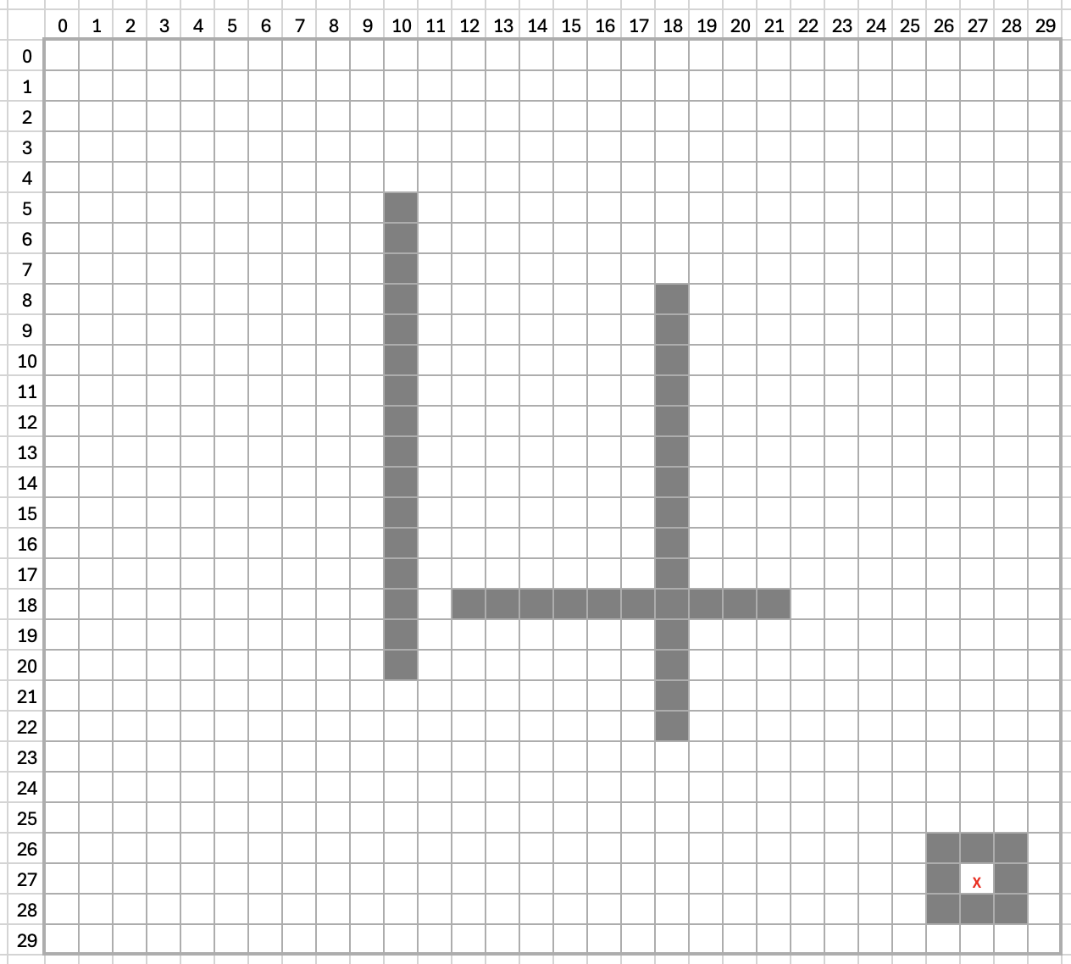
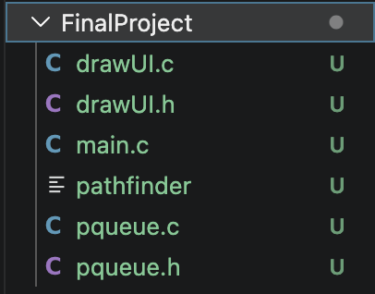
07 · DEMO
Map Layout
Live Demo: 30×30 Grid
Files
Build & Run
././Final\ Project
clang main.c pqueue.c drawUI.c -o pathfinder
./pathfinder
Prototype of the actual terminal output from our program
Interaction Flow
Two long straight walls + one connecting wall
Enter Start / Goal → Watch A* animate → Press Enter → Watch Dijkstra animate
→ Press Enter → Show final comparison table
A fully closed 3×3 box around (27, 27) — deliberately unreachable, to test “No path found.”
User types Start/Goal row & column; input is validated against walls and grid bounds
CS5008 Final Project | JSD Squad
11

Slide 12
RESULTS
Same Map, Same Optimal Path — Different Effort
Both algorithms report identical path length on our test maps — A* simply reaches that answer while exploring fewer nodes.
Algorithm | Path Length | Explored Nodes
A* | same as Dijkstra | fewer ↓
Dijkstra | same as A* | more ↑
Takeaways
The heuristic doesn't change correctness — it changes efficiency, by reordering which cells get explored first.
The gap grows with map size: on larger, more open grids, A* explores a visibly smaller region than Dijkstra.
When there's no useful heuristic (e.g. finding paths to every location), Dijkstra is the right tool — A* offers no benefit.
CS5008 Final Project | JSD Squad
12

Slide 13
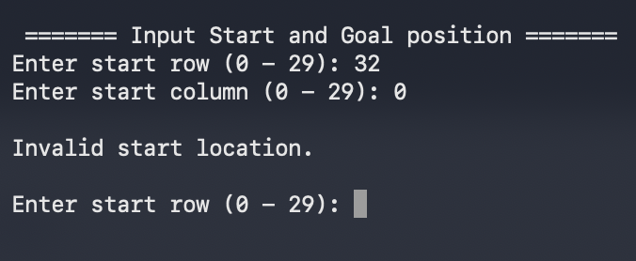
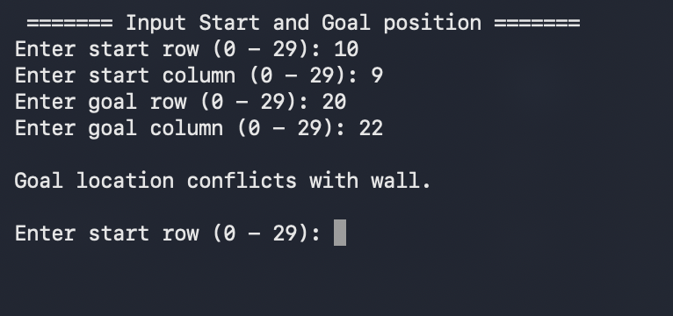
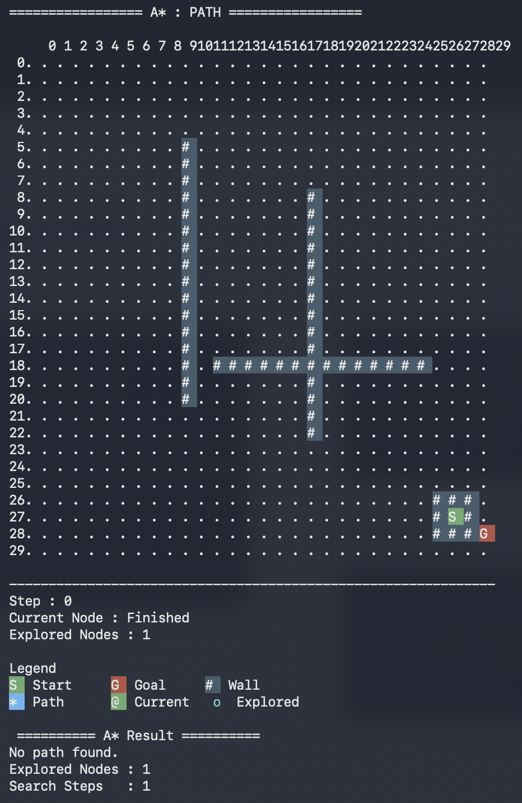
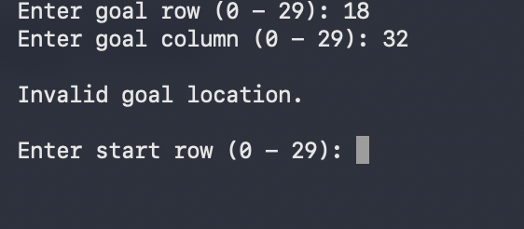
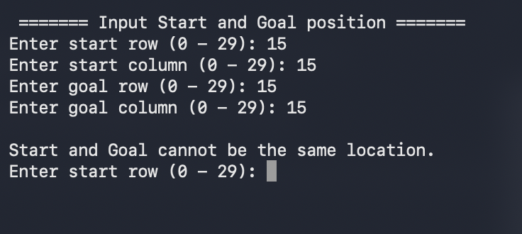
08 · TESTING
Testing Cases
“No path found” when start/goal is set in a closed wall area
Validate start/goal is outside of grid
Validate start/goal conflicts with walls
Validate start and goal conflict

Slide 14
Q & A
Questions about the algorithms or the demo?

Slide 15
Thank You!
JSD Squad — Jenny Zhuo Wang • Sandra Yang Huang • Doudou Lei Tuo

